Slide 1
How to Maintain the Same Level of utilities in Cloud Deployments - Securability, Reliability and Scalability
Denny Cherry
Principal Consultant
Denny Cherry & Associates Consulting
mrdenny@dcac.co | twitter.com/mrdenny

Slide 2
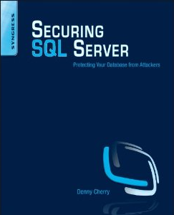
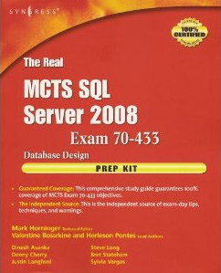

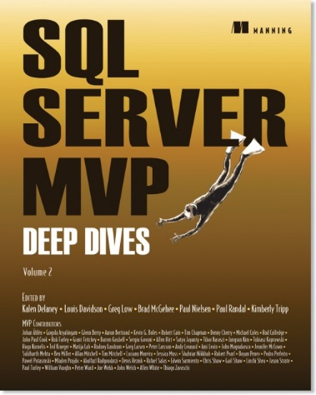



About Me
Denny Cherry & Associates Consulting
8 books
Dozens of articles
Microsoft MVP
Microsoft Certified Master
VMware vExpert

Slide 3
Agenda
Security in Azure
Availability in Azure
Scalability in Azure

Slide 4
Security In Azure
Encrypt all the things

Slide 5
Cloud Services – Shared Responsibility
On Premises
Infrastructure
(as a Service)
Platform
(as a Service)
Software
(as a Service)
Applications
Applications
Applications
Applications
Data
Data
Data
Data
Managed by:
Runtime
Runtime
Runtime
Runtime
Middleware
Middleware
Middleware
Middleware
Customer
O/S
O/S
O/S
O/S
Vendor
Virtualization
Virtualization
Virtualization
Virtualization
Servers
Servers
Servers
Servers
Storage
Storage
Storage
Storage
Networking
Networking
Networking
Networking
Notes:
Shared Responsibility A Key To Effective Cloud Security. The cloud service provider is responsible for the security of the infrastructure and the customer of the cloud service provider is responsible for security of the application or service running on top of the infrastructure.

Slide 6
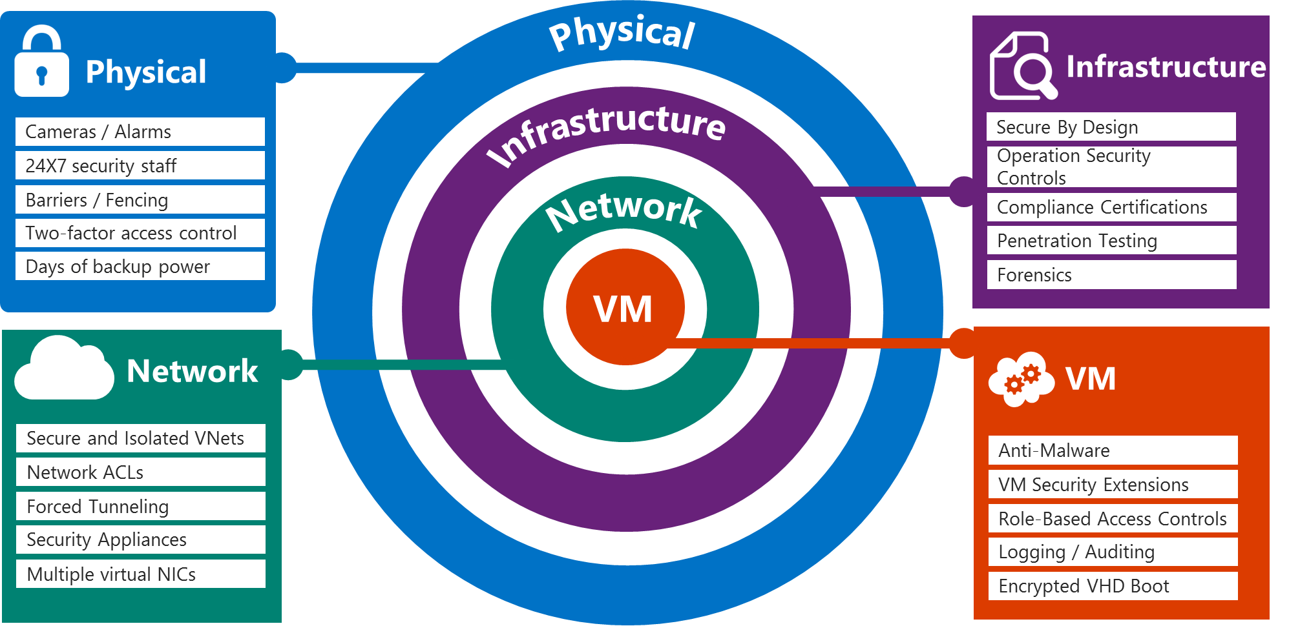
Security (Architecture? Defense in depth?)
Notes:
Physical Infrastructure Slide script:
Azure infrastructure includes hardware, software, administrative and operations staff, and physical data centers. Windows Azure addresses security risks across its infrastructure with continuous intrusion detection and prevention systems, denial of service attack prevention, regular penetration testing, and forensic tools that help identify and mitigate threats. With this level of protection, Azure, customers can reduce the need to invest in these capabilities on their own and benefit from economies of scale in Microsoft datacenter infrastructure.
24-hour monitored physical security. Microsoft datacenters are physically constructed, managed, and monitored 24 hours a day to shelter data and services from unauthorized access as well as environmental threats.
Monitoring and logging. Centralized monitoring, correlation, and analysis systems manage the large amount of information generated by devices within the Azure environment, providing continuous visibility and timely alerts to the teams that manage the service. Additional monitoring, logging, and reporting capabilities provide visibility to customers.
Software update management. Security patches help protect systems from known vulnerabilities. Integrated deployment systems manage the distribution and installation of security updates for Microsoft software. Customers can apply similar update management processes for virtual machines (VMs) deployed on Azure.
Anti-Virus/Anti-Malware protection. Azure software components must go through a virus scan prior to deployment. Code is not moved to production without a clean and successful virus scan. Microsoft recommends that customers run some form of anti-malware or anti-virus on all virtual machines (VMs). Customers can install Microsoft Endpoint Protection or another antivirus solution on VMs, and VMs can be routinely reimaged to clean out intrusions that may have gone undetected.
Intrusion /DDoS Defense. Azure has a defense system against Distributed Denial-of-Service (DDoS) attacks on Azure platform services. It uses standard detection and mitigation techniques. Azure’s DDoS defense system is designed to withstand attacks generated from outside and inside the platform.
Penetration testing. Microsoft conducts regular penetration testing to improve Windows Azure security controls and processes. Customers can carry out authorized penetration testing on their applications hosted in Windows Azure.
Network Slide script:
Azure networking provides the infrastructure necessary to securely connect VMs to one another and to connect on-premises data centers with Azure VMs. Azure blocks unauthorized traffic to and within Microsoft data centers using a variety of technologies such as firewalls, NATs, partitioned Local Area Networks and physical separation of back-end servers from public-facing interfaces.
Network isolation. In Azure, a customer subscription can include multiple deployments, and each deployment can contain multiple tenants, or virtual machines (VMs). Network isolation prevents unwanted tenant-to-tenant communications, and access controls block unauthorized users from the network. Virtual machines do not receive inbound traffic from the Internet unless customers configure them specifically to do so. The overarching principle within Azure is to allow only connections and communications that are necessary for cloud services to operate, blocking all other ports and connections by default.
Virtual Networks. A customer can choose to assign multiple deployments within a subscription to a virtual network and allow those deployments to communicate with each other through private IP addresses. Each virtual network is isolated from other virtual networks.
VPN and ExpressRoute. Microsoft enables connection from customer sites and remote workers to Azure Virtual Networks using Site-to-Site and Point-to-Site VPNs. For even better performance, customers can use an optional Express Route, a private fiber link into Azure data centers that keeps their traffic off the Internet.

Slide 7
Data encryption
Application
.Net Encryption API
Client side encryption with Azure Key Vault
SQL TDE on SQL Server on Azure IaaS servers
Platform
SQL Azure TDE
Dynamic Data Masking
Row-Level Security
Auditing & Threat Detection
System
BitLocker
Azure Storage Account Encryption (In Preview)
3rd Party Disk Encryption
Notes:
Slide title: Data encryption
Slide objective: Explain data encryption layers available with Microsoft Azure.
Slide script:
Application layer
.NET: The .NET Framework provides implementations of many standard cryptographic algorithms. These algorithms are easy to use and have the safest possible default properties. In addition, the .NET Framework cryptography model of object inheritance, stream design, and configuration is extremely extensible.
SQL TDE/CLE: Transparent data encryption (TDE) is designed to provide protection for the entire database at rest without affecting existing applications. Implementing encryption in a database traditionally involves complicated application changes such as modifying table schemas, removing functionality, and significant performance degradations. Microsoft SQL Server offers two levels of encryption: database-level and cell-level. Both use the key management hierarchy.
Platform Layer
SQL Azure: SQL Azure Transparent Data Encryption (TDE), Dynamic Data Masking, Row-level security (RLS), Auditing & Threat Detection
StorSimple: Instead of tape backup or remote replication, StorSimple arrays protect data automatically with cloud snapshots. Cloud snapshots are similar to local snapshots in other products, but are stored remotely in cloud storage where they can be quickly accessed online without the lengthy delays normally incurred with off-site storage.
Key Vault: Secure key management is essential to protecting data in the cloud. With Key Vault, you can encrypt keys and small secrets like passwords with keys stored Hardware Security Modules (HSMs). For added assurance, import or generate your keys in HSMs certified to FIPS 140-2 level 2 standards – so that your keys stay within the HSM boundary. Key Vault is designed so that Microsoft does not see or extract your keys.
System Layer
BitLocker: BitLocker Drive Encryption allows you to encrypt all data stored on the Windows operating system volume and configured data volumes. A Trusted Platform Module (TPM) is a microchip that is built into a computer. It is used to store cryptographic information, such as encryption keys. Information stored on the TPM can be more secure from external software attacks and physical theft. BitLocker uses the TPM to help protect the Windows operating system and user data and helps to ensure that a computer is not tampered with, even if it is left unattended, lost, or stolen.
Azure Disk Encryption for VM: Azure Disk Encryption is a new capability that lets you encrypt your Windows and Linux IaaS virtual machine disks. Azure Disk Encryption leverages the industry standard BitLocker feature of Windows and the DM-Crypt feature of Linux to provide volume encryption for the OS and the data disks. The solution is integrated with Azure Key Vault to help you control and manage the disk encryption keys and secrets in your key vault subscription, while ensuring that all data in the virtual machine disks are encrypted at rest in your Azure storage.
URL: https://azure.microsoft.com/en-us/documentation/articles/azure-security-disk-encryption/

Slide 8
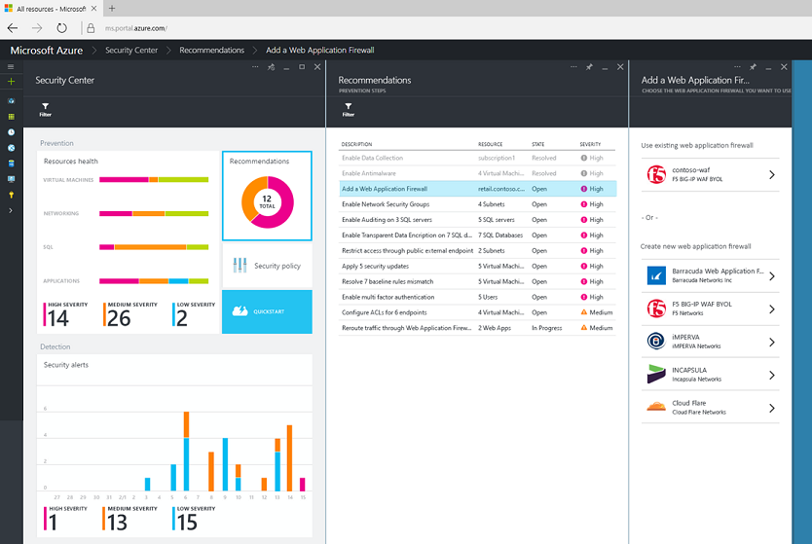
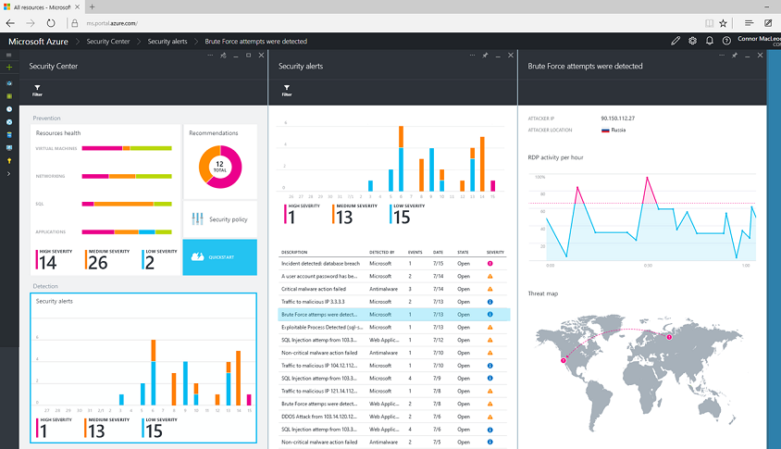
Azure Security Center (preview)
Gain visibility and control
Integrated security, monitoring, policy management
Built in threat detections and alerts
Notes:
Azure Security Center provides a unified view of your security state, so your team and/or your organization’s security specialists can get the information they need to evaluate risk across the workloads they run in the cloud. Based on customizable policy, the service can provide recommendations. For example, the policy might be that all web applications should be protected by a web application firewall. If so, the Azure Security Center will automatically detect when web apps you host in Azure don’t have a web application firewall configured, and provide a quick and direct workflow to get a firewall from one of our partners deployed and configured.
Of course, even with the best possible protection in place, attackers will still try to compromise systems. To address this problem and adopt an “assume breach” mindset, the Azure Security Center uses advanced analytics, including machine learning, along with Microsoft’s global threat intelligence network to look for and alert on attacks. Signals are automatically collected from your Azure resources, the network, and integrated security partner solutions and analyzed to identify cyber-attacks that might otherwise go undetected. Should an incident occur, security alerts offer insights into the attack and suggest ways to remediate and recover quickly. Security data and alerts can also be piped to existing Security Information and Events Management (SIEM) systems your organization has already purchased and is using on-premises.
No other cloud vendor provides the depth and breadth of these capabilities, and they are going to enable you to build even more secure applications in the cloud.

Slide 9
Common Mistakes
Setting up Public IPs for SQL Servers
When VMs have a public IP there’s no firewall between VM and Internet
Always configure Network Security Group
Not using VPN between On-Premises and Azure
Site to Site
Person to Site
RRAS Server
Not encrypting at rest
TDE
Storage Encryption
Notes:
Everything here assumes RM

Slide 10
Public IPs for Servers
No SQL Server needs to be accessed directly from the Internet
If your application requires direct access from the Internet, you’ve designed the application wrong

Slide 11
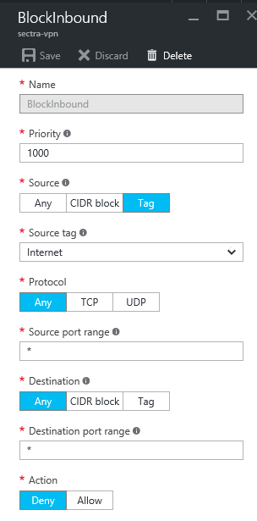
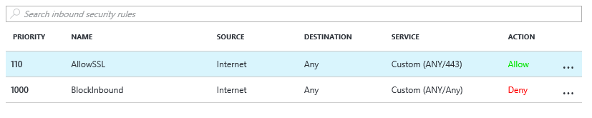
Public IPs for Servers
If you MUST have a public IP
Use a Network Security Group to block all access from the Internet

Slide 12
Availability in Azure
Be able to access all the things all the time

Slide 13
Some Common Misconceptions
“Oh, it’s just VMs in the cloud”
“Just like private cloud on prem”
“Microsoft hosts a bunch of Hyper-V servers in their datacenter”
Notes:
We want to clear up some common misconceptions heard when comparing IAAS on Azure to Onpremises workloads, co-hosters or managed service providers.

Slide 14
Azure has HA, why Do I need HA?
No availability SLA without HA within your VMs
Hardware fails
Hosts need patching
You have no control of host patching

Slide 15
Availability Sets
Configure multiple virtual machines in an Availability Set for redundancy
Configure each application tier into separate Availability Sets
Combine the Load Balancer with Availability Sets
Notes:
Understanding and using Availability sets is the first step in creating redundant VM Solutions, By having Availability Sets you will protect yourself for outages due to planned Azure maintenance. To provide redundancy to your solution, we recommend that you group two or more virtual machines in an Availability Set. This configuration ensures that during either a planned or unplanned maintenance event, at least one virtual machine will be available
For multi tiered solutions you should configure each tier in a separate availability set. By configuring at least two virtual machines in an Availability Set for each tier, you guarantee that at least one virtual machine in each tier will be available during maintenance events
Combine the Azure Load Balancer with an Availability Set to get the most application resiliency. The Azure Load Balancer distributes traffic between multiple virtual machines. For our Standard tier virtual machines, the Azure Load Balancer is included. Note that not all virtual machine tiers include the Azure Load Balancer
In the future Azure will start offering Availability Zones which will allow you to extend the Availability Set across two data centres (provided that the latency between them is below 2 msec)

Slide 16
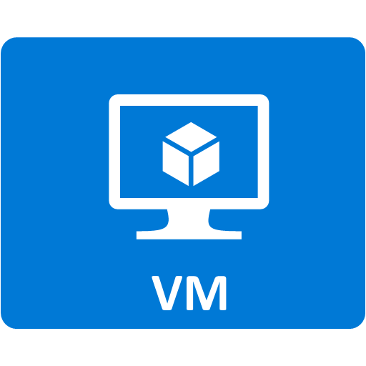
Availability Sets
Recommended for workloads with 2+ VM’s
Azure has knowledge of your server topology – won’t shut down all instances during host upgrades.
Provides physical redundancy at the server, power, and network level
Required to achieve 99.95% SLA
Fault Domain
Fault Domain
Server Rack
Server Rack
Availability Set
Availability Set
Notes:
When deploying virtual machines where more than one VM will service a workload such as a set of web servers or domain controllers it is highly recommended to create them in an availability set.
By doing so, Azure has some basic knowledge about the structure of your application topology. When updating the underlying host, Azure will perform rolling updates across the instances in the available set, taking down only a portion of your servers for the actual update.
<click>
Putting VMs in an availability also tells Azure to provision the VM’s on separate physical racks in the data center so your servers have physical redundancy at the server, power and network level. If a failure even at the rack level occurs, a minimum of half of your applications servers will still be available on separate physical hardware.
Shown here is what we call a Fault Domain in Azure. A Fault Domain isolates virtual machine instances for faults.
To achieve the 99.95% SLA Availability Sets are required.

Slide 17
HA Options
Always On Availability Groups
Internal Load Balancer
Always On Failover Cluster
Internal Load Balancer
3rd Party Software for block level replication
Mirroring
Depricated

Slide 18
DR Options
Always On Availability Groups
Internal Load Balancer
Always On Failover Cluster
Internal Load Balancer
3rd Party Software for block level replication
Mirroring
Depricated

Slide 19
What HA Comes With Azure VMs
Storage
Network

Slide 20
HA in SQL DB
Microsoft provides HA for all PaaS solutions
3 copies of your databases on 3 VMs in a single availability set
HA provided by an Always On Availability Group like solution

Slide 21
DR in SQL DB
Geo-Replication provides you with DR
Basic – 1 DR Site
Standard – 1 DR Site
Premium – 1 DR Site and 3 other sites
Failover at different levels based on need
Database
SQL Server (in preview)

Slide 22

Azure SQL Database Active Geo-Replication
Mission-critical business continuity on your terms, via programmatic APIs
Self-service activation
Create up to 4 readable secondaries
Replicate to any Azure region
Automatic data replication, asynchronous
REST API, PowerShell or Azure Portal
RTO < 30s
RPO < 5s
Up to 4 secondaries
Notes:
Azure SQL Database Premium enables replication to up to 4 regions worldwide. Active geo-replication, available for Premium databases, provides the richest solution with the least risk of data loss and the most rapid recovery time. It extends standard geo-replication with up to 4 geo-replicated secondaries that are online and readable at all times, and which can also be used for load balancing or to provide low-latency access to replicated data anywhere in the world.
https://azure.microsoft.com/en-us/blog/spotlight-on-sql-database-active-geo-replication/
The thing to remember is that all writes need to be performed in a single region, while all reads can be performed in up to 5 regions.

Slide 23
Scalability In Azure
Give me the things faster

Slide 24

Scaling Options
Scale Up
Vertical scale
Increase resource capacity within existing nodes
Scale Out
Horizontal scale
Increase resource capacity by adding nodes
Notes:
There are two approaches to scaling a system to meet demand: scaling up and scaling out.
<click>
Scaling up means increasing resource capacity within existing nodes. This means adding more memory, more CPU, more disk space.
<click>
We start with a server and, when we determine that the workload demands it, we increase existing resources.
<click>
Scaling out means that we increase resource capacity by adding nodes.
<click>
We start with a server and, when we determine that the workload demands it, we add additional resources and spread the load across the resources.

Slide 25
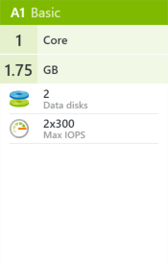
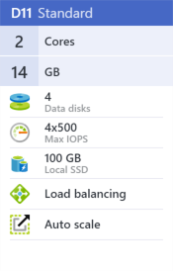
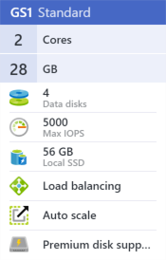
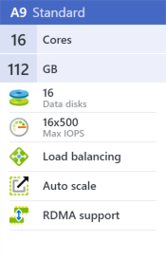
Capacity and Features
VM size determines compute capacity
# of cores
VM size determines features
Auto-scale
RAM
# of disks
local SSD
load balancing
RDMA
Premium storage support
Notes:
The size of your virtual machine will determine the compute capacity available on your VM instance. For example, the number of cores, amount of memory, number of data disks you can attach, are all determined by the size of the virtual machine.
To the right are just a few of the virtual machine sizes you could choose from and you can see how the compute capacity varies from one to the next.
<click>
The size of your virtual machine also determines the features available to your VM instance. For example, if you need support for load balancing, or want to be able to auto-scale the number of instances up or down based on server load, then you will need to choose a VM size that offers those features.

Slide 26

Virtual Machine Tiers
Standard Tier VM’s
Series A, D, Dv2, DS, G, GS (general purpose to high performance)
Most flexible – full feature support
Basic Tier VM’s
General purpose compute
No support for load balancing, auto-scale, or high memory requirements
Notes:
Virtual Machine sizes are grouped into two tiers; Standard and Basic Tier VM’s.
The Standard Tier VM’s are most common for production workloads. Within the standard tier, there are multiple series (or classes) of VM’s available that offer increasing compute capacity across the tiers. The Standard Tier VM’s is feature rich as well, providing support for load-balancing and high-memory workloads.
The Basic tier offers more affordable general compute options, but without the features that a production environment typically require. These are ideal for Dev/Test scenarios or small workloads that don’t require features such as load-balancing.

Slide 27
Scale in SQL Server VMs
Always On Availability Groups
Scales out reads
Merge Replication
Scales out reads and writes
Peer to Peer Replication
Scales out reads and writes
Transactional Replication
Scales out reads
Enterprise Edition
Standard Edition
Enterprise Edition
Standard Edition
Scale reads to SQL DB or SQL Server VMs
Data Movement via Queues
Developed in house
Ultimate flexibility as you own the code
Can combine SQL Server VMs with SQL DB
Notes:
If you need to rebuild your solution for this kind of scale, then moving to a straight SQL DB solution would probably be the best option.

Slide 28

Scale in SQL DB
Size up
Sharding
Basic - B
Standard – S0, S1, S2, S3
Premium – P1, P2, P4, P6, P11, P13
Elastic Pools
Basic – 100, 200, 400, 800, 1200
Standard – 100, 200, 400, 800, 1200
Premium – 125, 250, 500, 1000, 1500
Single tenant per database
Readable Secondary
Basic – 1 secondary
Standard – 1 secondary
Premium – 4 secondary
Central database for authentication and database routing
Managed Instances
Instance level SQL DB instead of Database level SQL DB

Slide 29



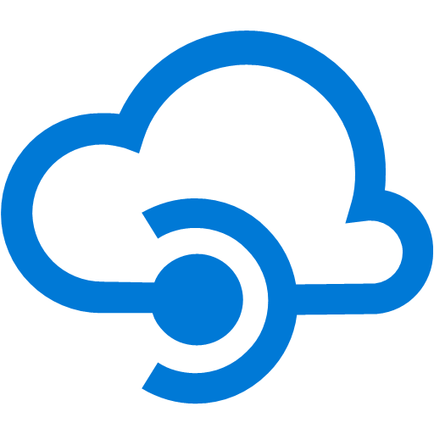
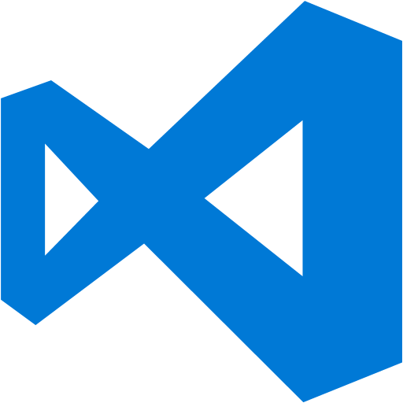
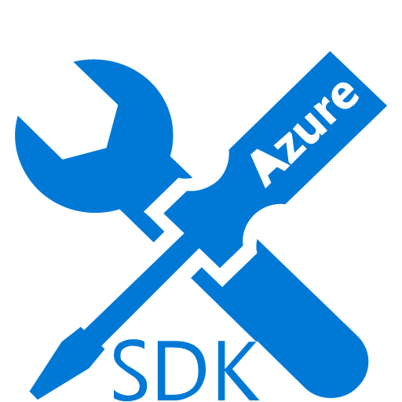
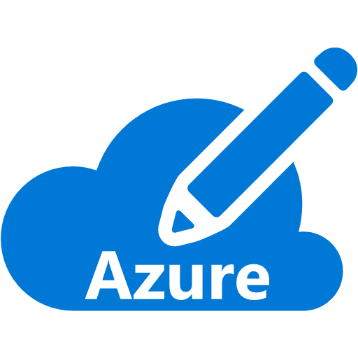
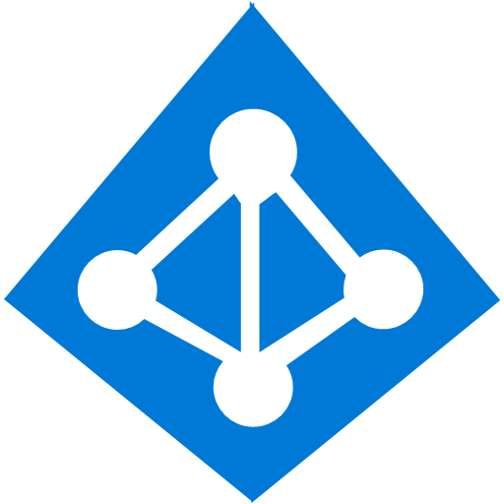
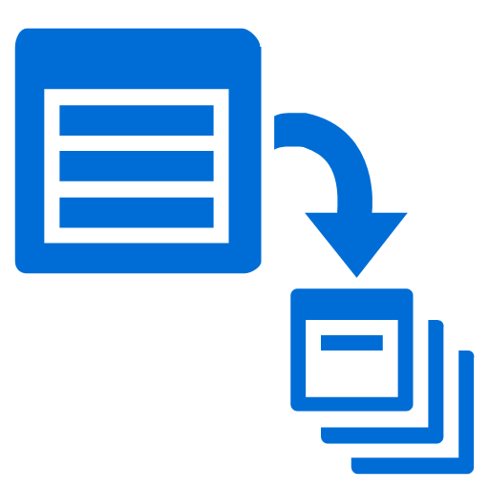

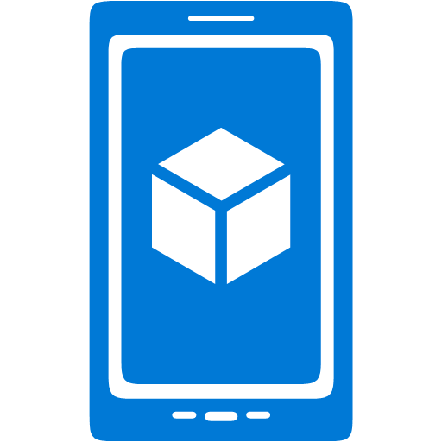





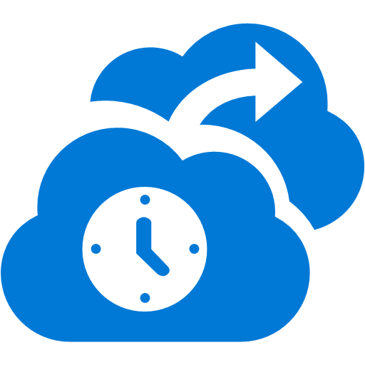

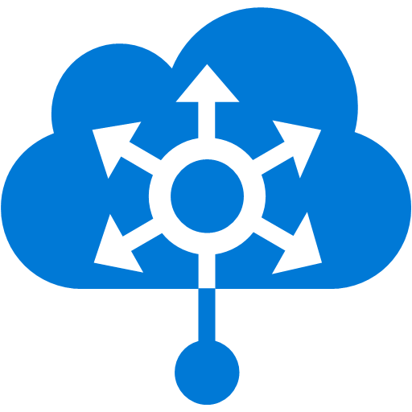



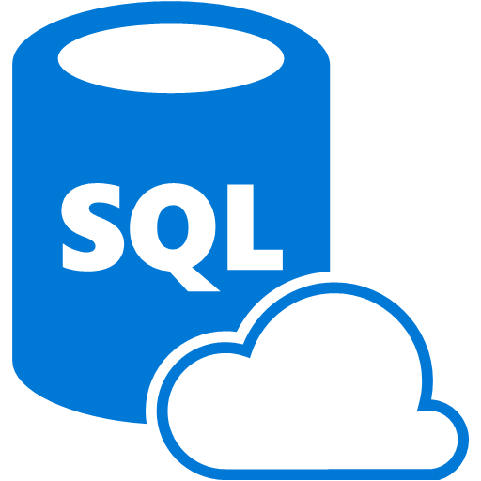


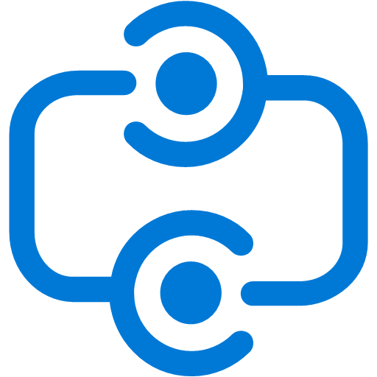
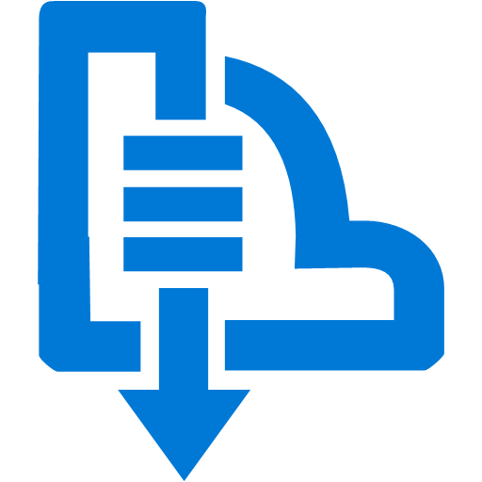

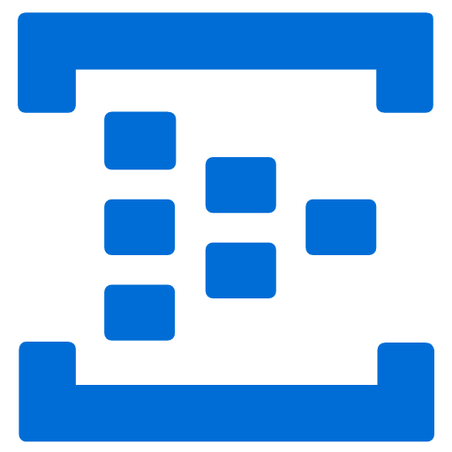


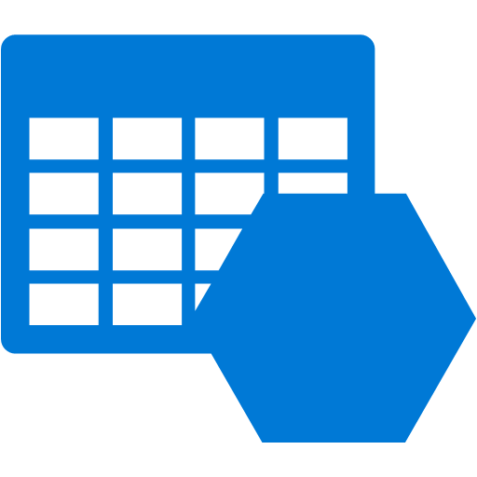

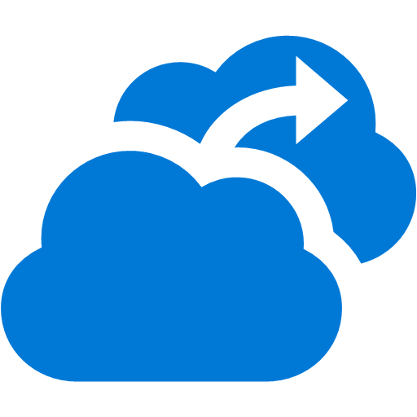


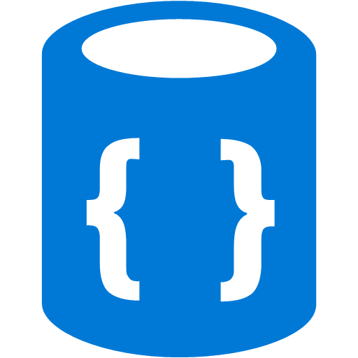
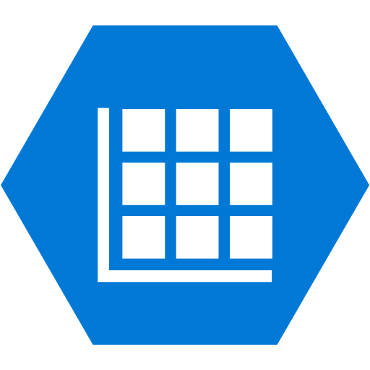




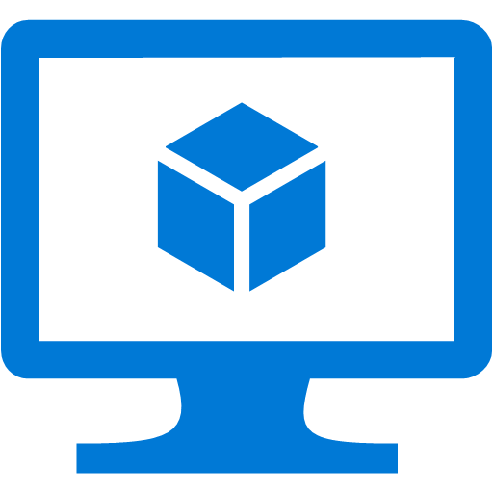
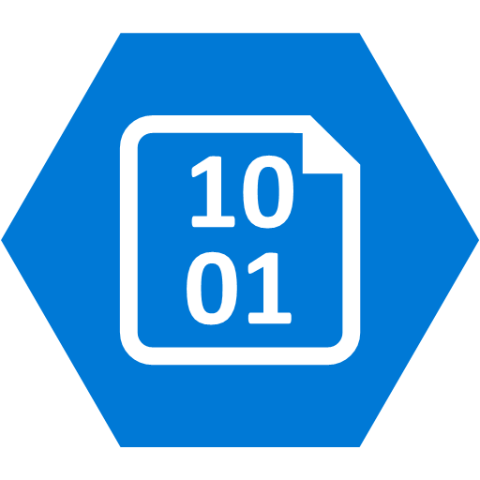
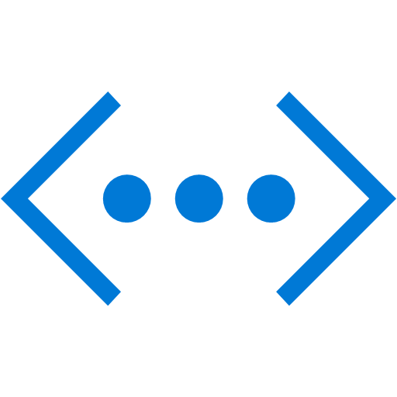
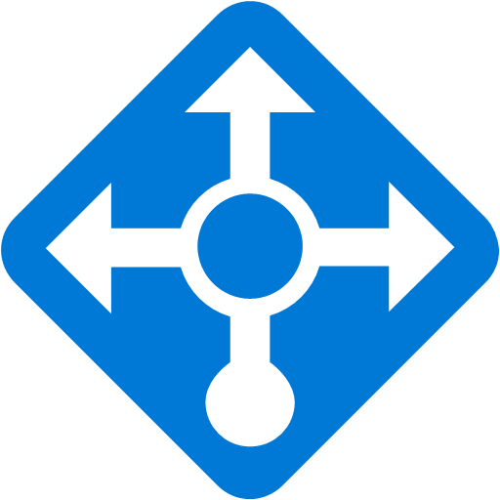
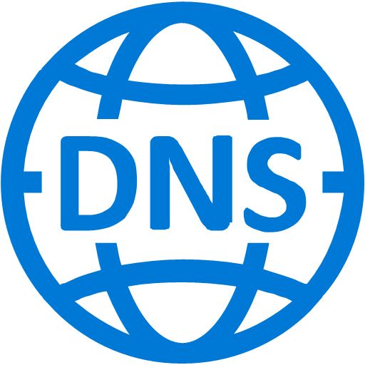
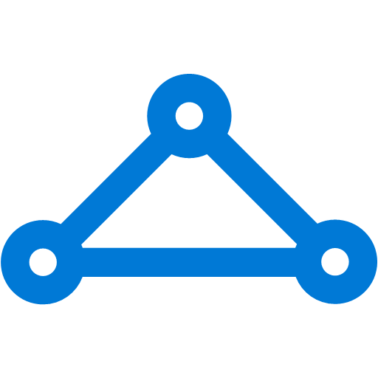

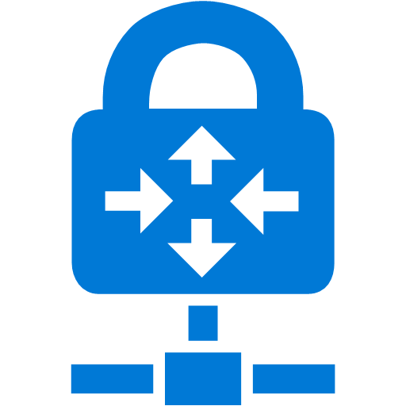
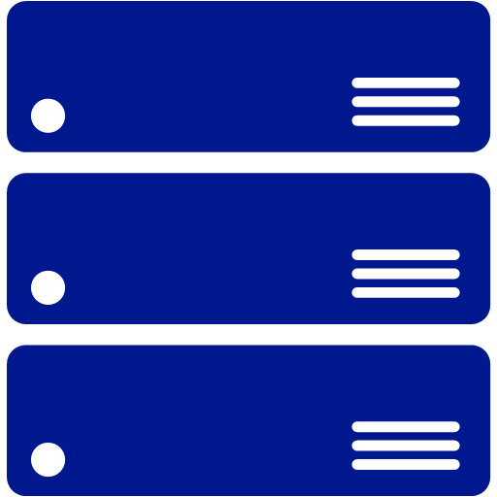
Platform Services
Security & Management
Compute
Web and Mobile
Developer Services
Hybrid
Operations
Cloud
Services
Service
Fabric
Web Apps
API
Apps
API
Management
Visual Studio
Azure SDK
Portal
Azure AD
Connect Health
Batch
Remote App
Mobile
Apps
Logic
Apps
Notification
Hubs
Team Project
Application
Insights
Active
Directory
AD Privileged
Identity
Management
Multi-Factor
Authentication
Integration
Analytics & IoT
Data
Backup
Storage
Queues
Biztalk
Services
Automation
HDInsight
Machine
Learning
SQL
Database
SQL Data
Warehouse
Operational
Insights
Hybrid
Connections
Service
Bus
Key Vault
Data
Factory
Event
Hubs
Redis
Cache
Search
Import/Export
Store /
Marketplace
Media & CDN
Site
Recovery
Stream
Analytics
Mobile
Engagement
DocumentDB
Tables
VM Image Gallery
& VM Depot
Media
Services
Content Delivery
Network (CDN)
StorSimple
Infrastructure Services
Compute
Storage
Networking
Virtual Machines
Containers
BLOB Storage
Azure Files
Premium Storage
Virtual Network
Load Balancer
DNS
Express
Route
Traffic Manager
VPN Gateway
Application Gateway
Datacenter Infrastructure (24 Regions, 19 Online)*
Notes:
Use the correct services for the database. There’s lots of ways to store data in azure. SQL Server and/or SQL DB may not be the correct one.

Slide 30
Active/Active Databases
Every region is writeable
Eventual consistency pattern
Requires reconciliation processing
Built by you based on application needs

Slide 31
Active/Active Databases
Writes to a central location
Writes all data to all locations
Uses queues to forward data to all databases
Eventually consistent database model

Slide 32
Factors That Limit Scalability
Problem | Symptom Area
Stateful applications | MEMORY
Synchronous calls | CPU
Storage bottlenecks | DISK
Communication latency | NETWORK
Notes:
There are 4 common architectural problems that limit scalability.
Stateful applications that hold state in memory requires that applications cannot be load-balanced. Holding state in memory means that you increase pressure unevenly in each node, creating hotspots of memory usage.
Synchronous calls to dependent resources such as REST APIs blocks threads and creates CPU contention.
Storage performance can limit an application’s ability to accommodate increased work when the system cannot persist data at a rate fast enough to match incoming work.
Communications latency also limits an application's ability to accommodate increased work when the system must wait on latent networks, such as communicating to resources that are not closely located.
Troubleshooting these symptoms means that you need to monitor the system’s performance in terms of memory, CPU, disk, and network.
When one becomes a bottleneck, the solution is to move the problem to one of the other 3 areas, making tradeoffs. For instance, moving complex processing to another node across the network to reduce CPU, and increasing cached data in memory to reduce network usage.

Slide 33
Questions
?

Slide 34
What We’ve Covered
Security in Azure
Availability in Azure
Scalability in Azure

Slide 35
How to Maintain the Same Level of utilities in Cloud Deployments - Securability, Reliability and Scalability
Denny Cherry
Principal Consultant
Denny Cherry & Associates Consulting
mrdenny@dcac.co | twitter.com/mrdenny

